Slide 1
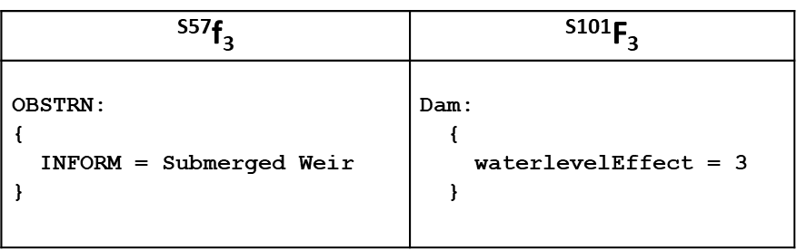
S-57 => S-101 Conversion Optimisation

Slide 2

aims and objectives
Aims
Systematically, Look at how S-57 could be “optimised” to prepare data for conversion to S-101
Examine current converter, process and results
Report, summarise and suggest next steps / recommendations
What have we done?
Developed a systematic methodology
Carried out intensive data conversion
Analysis of results
UOC vs DCEG comparison
Reporting…

Slide 3
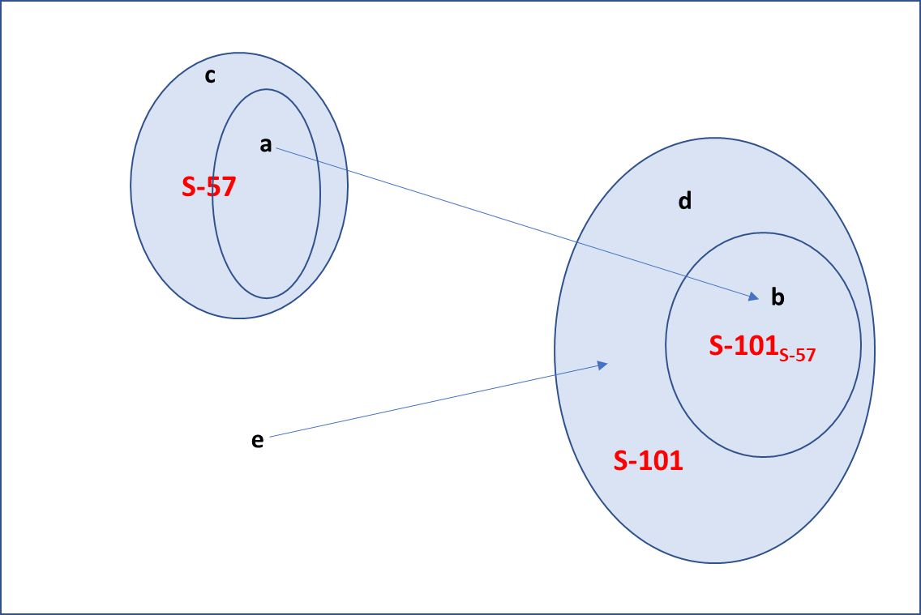
Feature categories
(a) Things in S-57 which can be translated into an S-101 equivalent without loss
(b) The domain of features defined by the S-57 source
(c) Anything in S-57 which can’t be (or doesn’t need to be) translated into an S-101 equivalent
(d) Features defined in S-101 which have no defining mechanism in S-57
(e) Real world features which previously had no representation in S-57 which are now expressible in S-101 (these are encoded into features (d)).
The Universe…

Slide 4
Categories of features
ICNZNE
CTRPNT
TS_TIS.
WEDKLP
Vessel traffic service area
Weed/Kelp
fibre optic cable

Slide 5
Simple transformation of a feature.
^{S57}f₁ | ^{S101}F₁
CANALS: { OBJNAM = Snapper Creek Canal SCAMIN = 259999 } | Canal: { featureName: { displayName=0 language=eng name=Snapper Creek Canal } scaleMinimum=259999 }

Slide 6
A slightly more complex transformation
^{S57}f₂ | ^{S101}F₂
BOYSPP: { BOYSHP = 1 CATSPM = 27 COLOUR = 1,11 COLPAT = 1 INFORM = Danger shoal OBJNAM = Miami Springs Boat Club Shoal Buoy SORDAT = 20050628 SORIND = US,US,reprt,7thCGD,LNM 26/05 STATUS = 8 SCAMIN = 179999 } | BuoySpecialPurposeGeneral: { buoyShape=1 categoryOfSpecialPurposeMark=27 colour=1 colour=11 colourPattern=1 featureName: { displayName=0 language=eng name=Miami Springs Boat Club Shoal Buoy } status=8 scaleMinimum=179999 } additionalInformation provides { SupplementaryInformation: { language=eng text=Danger shoal } }

Slide 7
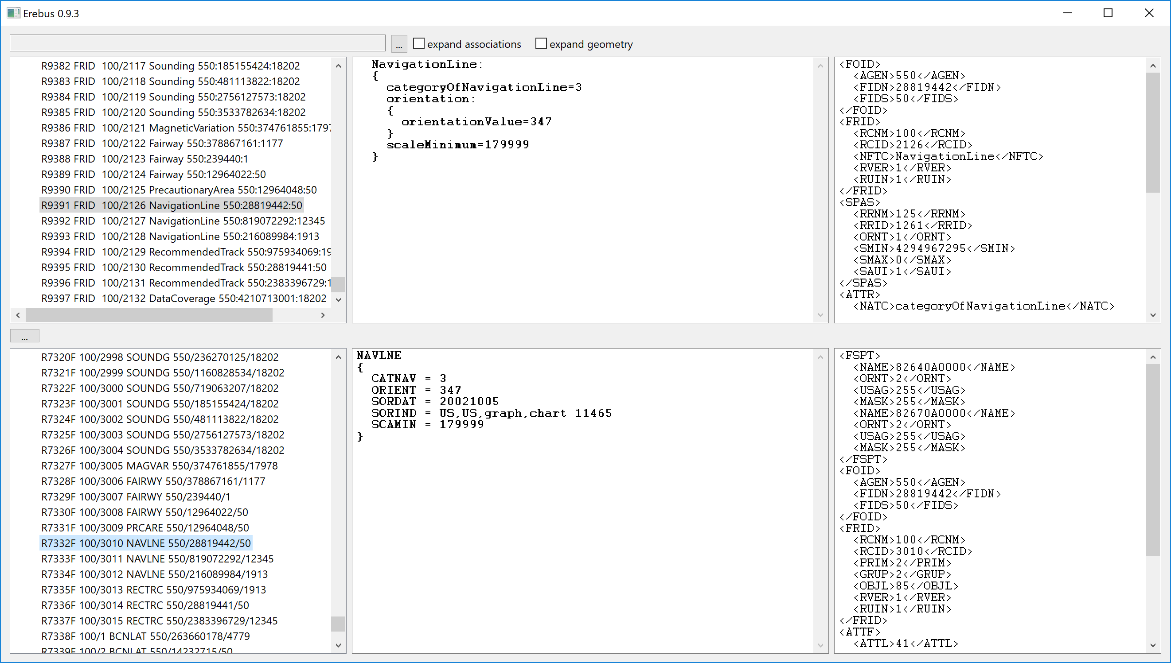
A slightly more complex transformation

Slide 8
Recommendations so far
Look at any issues that might be caused by deletion (or change) of feature classes, then of individual attribution.
Attribution where INFORM is currently used could be populated in S-101 cell. Could a standardised INFORM format be used to populate new attributes? Two forms
Population of attributes which exist in S-101 but not in S-57
Population of “InTheWater” which determines display – in this case coincident extraneous features aren’t needed
Aggregation of components of new S-101 aggregates, e.g Bridges, traffic separation schemes, pilot districts. Identification of their component parts.
Identification of features not expressible in S-57 but existing in S-101. Alternative encoding for conversion?
Look at SOE changes and areas where ambiguity in translation still exist (e.g RESARE)
Tag features encoded because of ECDIS display limitations and use them to define “intheWater”
Consideration of individual member state encoding guidelines.
This is a work in progress – converter will be upgraded/changed and FC/DCEG will evolve. Is there justification for a more formal set of conversion parameters?

Slide 9
Where INFORM is currently used to carry S-101 attribution
INFORM currently used heavily (66k attributed features on a sample of ~900 cells).

Slide 10
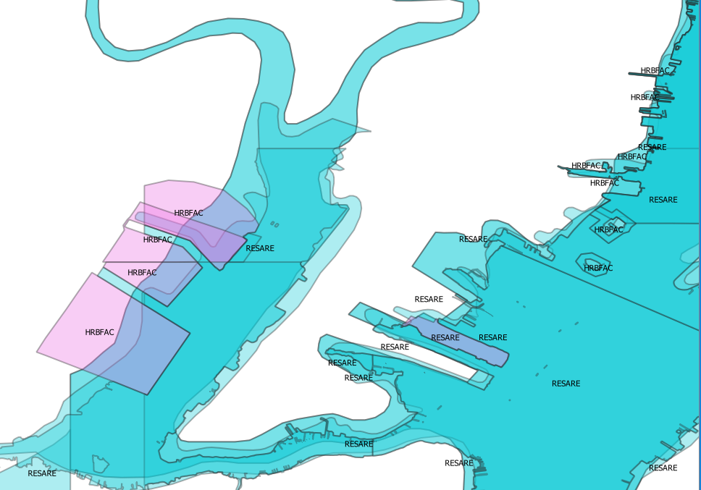
RESARE summary
Split into two features by RESTRN attribute
Multiplicity of RESTRN leaves an ambiguity to be r4esolved
No-wake area removed from regulatory. No conflicts but theoretically could exist.
Vessel speed limit? How to populate from INFORM (e.g US2EC02M:550:37358995:64399)
What to do about the other INFORM elements.? No information association mentioned.
In alarm/indications specifications the RESTRNs probably need to be split, i.e only nav RESTRNs precipate alarms in all features?
Fishing Grounds and Harbour facilities can now have restrictions. This would need coincident RESARE features in S-57 or INFORM to unambiguously attribute.
Restricted areas….
“no-wake area” removed.
navigational
regulatory

Slide 11
Features where extraneous co-incident features may exist
Sourced from UOC
Features which don’t display in ECDIS so may be encoded as something else:
GRDIRN(P), SLOGRD(CATSLO=null or != 6), RAPIDS(P), WATFAL(P), VEGATN(P, CATVEG=1), TUNNEL(P), DAMCON(P CATDAM=1), ROADWY(P), BRIDGE(P), RUNWAY(P), PRDARE(P, CATPRD=null), PIPSOL(P),
Member states may have others
Offshore CRANES
Offshore BUISGL, LNDMRK, SILTNK
Offshore FORSTC
SOUNDG(EXPSOU=2)
ACHARE (SEAARE) for naming
Offshore wind turbines
FSHFAC (OBSTRN)

Slide 12

How will migration S57=>S-101 take place?
Prod S/W
Prod S/W
Post-production conversion
After production of ENC data conversion takes place (somewhere)
End user systems are “single fuel”
Users are S-101 or S-57 and migration of user base takes place over a period of time
S-57
S-101
Conv S/W
Conv S/W
S-101
S-57
S-57
S-101
S-57
S-101

Slide 13
How will migration S57=>S-101 take place?
S-57 Prod S/W
S-101 Prod S/W
Prod S/W
Either:
Production software produces both S-57 and S-101
End user system (ECDIS) adds compatibility with S-101 format data (“dual fuel”)
S-57
S-101
S-57
S-101
S-57
S-101
S-57
Conv S/W
S-101

Slide 14
Current Converter – some observations
Startup errors
Tales from the Logfile
Things to check:
Multiple communication channels ([] separated in S-57) are translated into multiple attribute values in S-101 (multiple features, e.g PILBOP)
Submerged Weirs (no longer obstructions?)
Do attributes go to the aggregations (CATTSS?)
^{S57}f₃ | ^{S101}F₃
OBSTRN: { INFORM = Submerged Weir } | Dam: { waterlevelEffect = 3 }

Slide 15
continuing tales from the error log….
19k lines
“unable to bind attribute spatialquality” = 4,853 left.
Unique lines = 1,869
1 STATUS LNDMRK status Landmark.
1 STATUS SILTNK status SiloTank.
10 MARSYS BOYSPP marksNavigationalSystemOf BuoySpecialPurposeGeneral.
13 CATSPM BCNSPP categoryOfSpecialPurposeMark BeaconSpecialPurposeGeneral.
16 RESTRN RESARE restriction RestrictedAreaNavigational.
3 CATCOA COALNE categoryOfCoastline Coastline.
3 EXPSOU UWTROC expositionOfSounding UnderwaterAwashRock.
4 BCNSHP BCNLAT beaconShape BeaconLateral.
4 BCNSHP BCNSPP beaconShape BeaconSpecialPurposeGeneral.
4 RESTRN RESARE restriction RestrictedAreaNavigational.
5 RESTRN RESARE restriction RestrictedAreaNavigational.
7 CATOBS OBSTRN categoryOfObstruction Obstruction.
8 QUAPOS to feature
9 NATSUR UWTROC natureOfSurface UnderwaterAwashRock.
9 RESTRN RESARE restriction RestrictedAreaNavigational.
Info: Attribute CATTSS for feature ISTZNE dropped from S-101 feature InshoreTrafficZone.
Info: Attribute CATTSS for feature TSEZNE dropped from S-101 feature TrafficSeparationZone.
Info: Attribute CATTSS for feature TSSBND dropped from S-101 feature TrafficSeparationSchemeBoundary.
Info: Attribute CATTSS for feature TSSLPT dropped from S-101 feature TrafficSeparationSchemeLanePart.
Info: Attribute COLOUR for feature SBDARE dropped from S-101 feature SeabedArea.
Info: Attribute CONDTN for feature BRIDGE dropped from S-101 feature SpanFixed.
Info: Attribute CONDTN for feature BRIDGE dropped from S-101 feature SpanOpening.
Info: Attribute EXCLIT for feature LIGHTS dropped from S-101 feature LightFogDetector.
Info: Attribute EXPSOU for feature SOUNDG dropped from S-101 feature Sounding.
Info: Attribute HORCLR for feature BRIDGE dropped from S-101 feature Bridge.
Info: Attribute LITVIS for feature LIGHTS dropped from S-101 feature LightFogDetector.
Info: Attribute NATCON for feature OBSTRN dropped from S-101 feature Obstruction.
Info: Attribute ORIENT for feature M_NSYS dropped from S-101 feature NavigationalSystemOfMarks.
Info: Attribute QUASOU for feature DEPARE dropped from S-101 feature DepthArea.
Info: Attribute SCAMIN for feature BRIDGE dropped from S-101 feature SpanFixed.
Info: Attribute SCAMIN for feature BRIDGE dropped from S-101 feature SpanOpening.
Info: Attribute SCAMIN for feature COALNE dropped from S-101 feature Coastline.
Info: Attribute SECTR1 for feature LIGHTS dropped from S-101 feature LightFogDetector.
Info: Attribute SECTR2 for feature LIGHTS dropped from S-101 feature LightFogDetector.
Info: Attribute TECSOU for feature SWPARE dropped from S-101 feature SweptArea.
Info: Attribute VALNMR for feature LIGHTS dropped from S-101 feature LightFogDetector.

